Slide 1
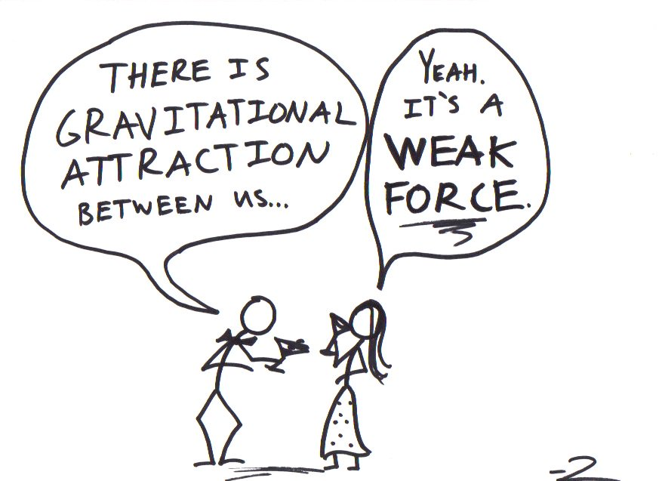

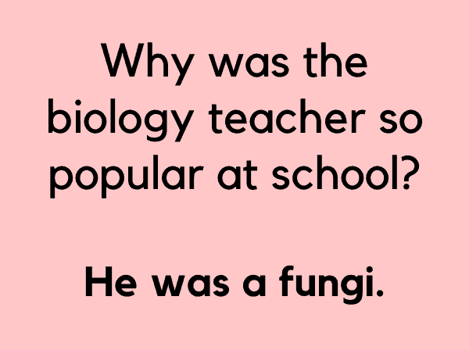
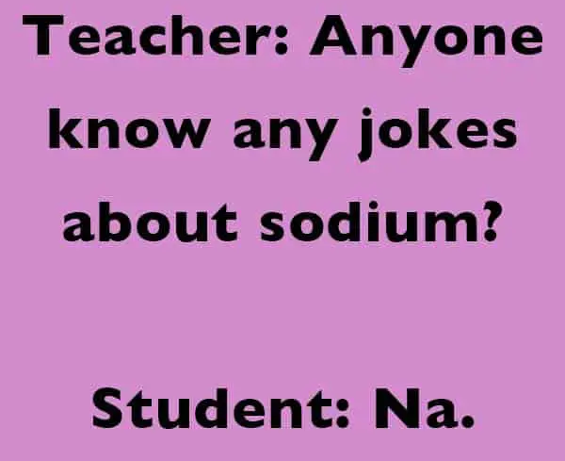
Y9 SCIENCE
INTRODUCTORY LESSON

Slide 2
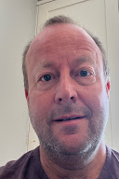

Who am I ?
Mr Phillips
You can call me Mr Phillips or Sir
My email is kennethphillips@sji-international.edu.my
I’ll be teaching KS3 Science, IGCSE Physics & AS Physics
I enjoy football and my favourite team is Newcastle United #HTL

Slide 3
Y9 Year plan - 2026-27
Includes the topics to be taught

Slide 4
Assessment overview
Multiple choice questions
Short-answer and structured questions
Questions on experimental skills
I will inform you at least two weeks in advance if there are any upcoming assessments.

Slide 5
Before the lesson
Line up along the wall – quietly and sensibly.
I will greet you at the door – do not enter the lab if I am not in it.
Get learning equipment on desk, write title, date and put your bag on the floor where it will not trip anyone up.

Slide 6
Expectations in the Lab
No eating in the lab
One voice
Use of devices only when required by the teacher
Awareness of what is happening around you, particularly in practical work

Slide 7

GOOGLE CLASSROOM
iwd4ixvn
nataliesiew@sji-international.edu.my

Slide 8
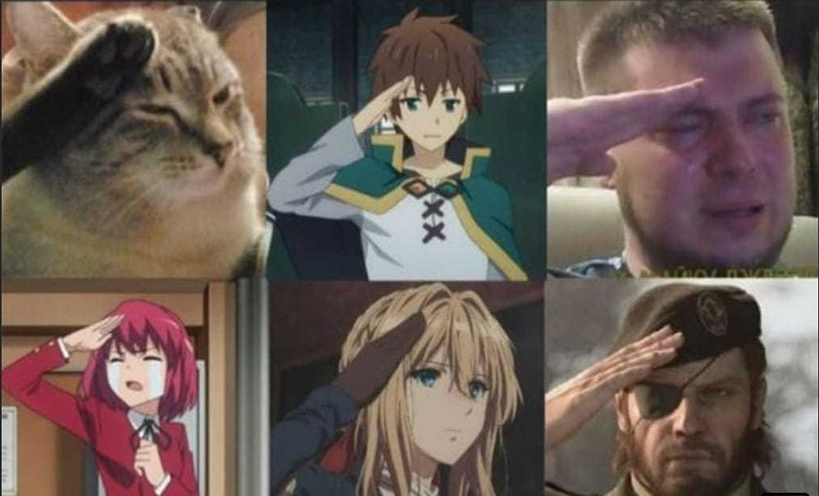
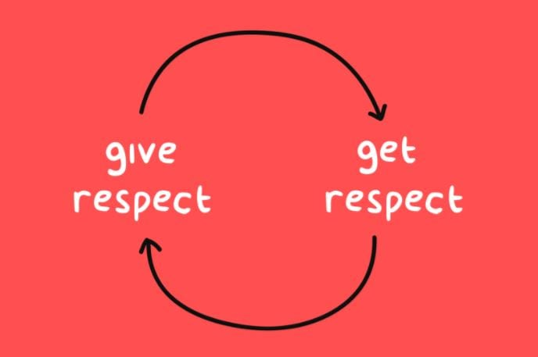
Three main values - 1

Slide 9

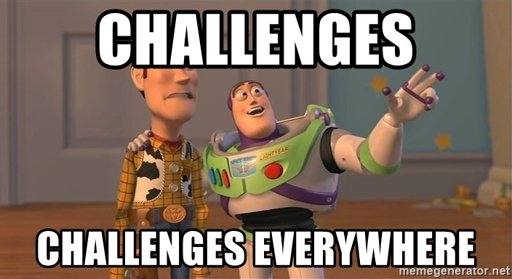
Three main values - 2

Slide 10

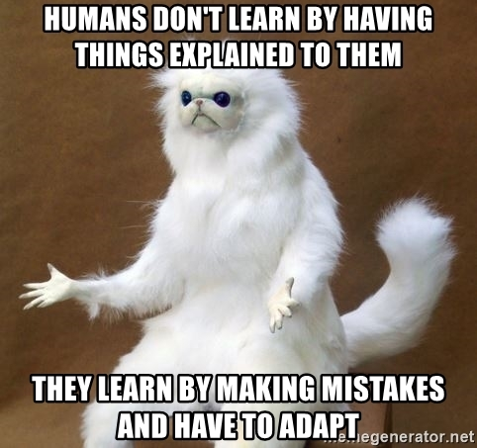
Three main values - 3

Slide 11
Expectations in Science
Be on time for lessons and line up outside the classroom
Complete all work both in class and homework - let me know if you cannot complete something on time
Ask any questions in comments section of GC or email me
If I want to ask a question, I will use the lollipop sticks.
If you want to ASK a question, you may raise your hand.
If someone is asking or answering a question, then everyone else should be listening.
Be kind and respectful of everyone in the classroom
Sensible scientists! - especially in practical lessons
Support each other - we are a team!

Slide 12

This is Me.
In at least one paragraph, show me who you are through words.
What is something special or unique about you?
What are your favourite hobbies or things to do?
What usually makes you happy?
Do you have any brothers, sisters, or pets?
What’s one thing you’d like me to know about you?
How are you feeling about being in this class?
Choose 3 words that best describe you!

